Slide 1

BUILDING A PHISHING DETECTION WEBSITE
Presented by
Hemant Shankar
Enrollment: 20DSMA023
Sem: 9th (BSMS)
Department of Mathematics
National Institute of technology, Agartala
Under the Supervision of
Dr. Supriyo Dutta (Assistant Professor)

Slide 2
WORKFLOW OF THE PROJECT
Fetching Data: Collecting Phishing and Legit Dataset
1
Feature Engineering: Clean and prepare data for training.
2
Data Analysis: Examine Data to identify trends and patterns
3
4
Model Training and Testing: Develop and evaluate model
Building Website UI: Design User Interface for interaction
5
Input Processing and Output Generation: Handle user inputs and produce detection results
6
Deploying Website: Launching the website for public use
7

Slide 3

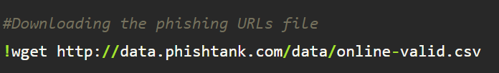
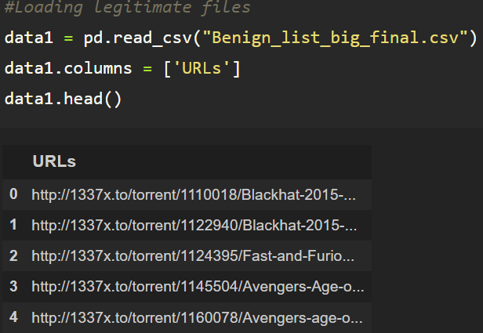
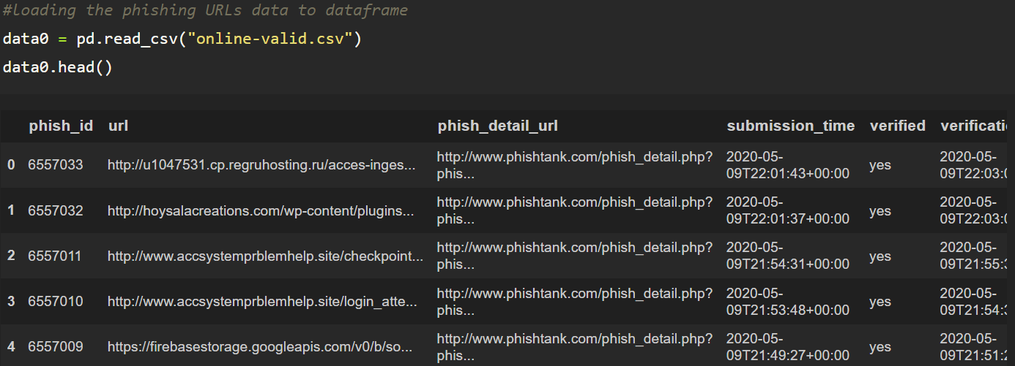
Data Collection
Gathered Phishing URLs
Gathered Legitimate URLs
Performed data scraping for two different types of URL data.

Slide 4
2. Feature Engineering
Extract Relevant Features
Address Bar based Features
Domain based Features
HTML & Javascript based Features
Domain of URL
IP Address in URL
"@" Symbol in URL
Length of URL
Depth of URL
Redirection "//" in URL
"http/https" in Domain name
Using URL Shortening Services “TinyURL”
Prefix or Suffix "-" in Domain
DNS Record
Website Traffic
Age of Domain
End Period of Domain
IFrame Redirection
Status Bar Customization
Disabling Right Click
Website Forwarding
A total of 17 new features are generated

Slide 5
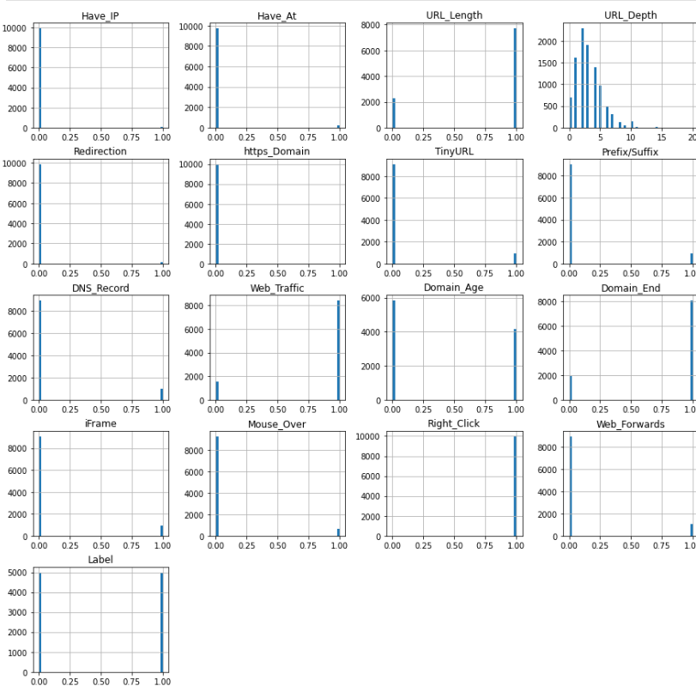
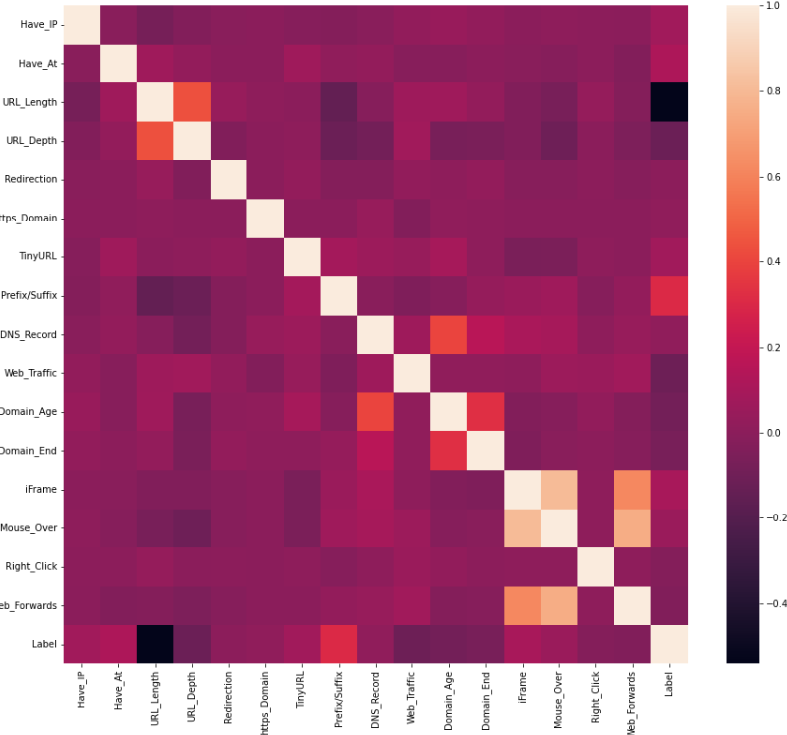
3. Data Analysis
Data Distribution Heatmap
2. Data Correlation Heatmap

Slide 6

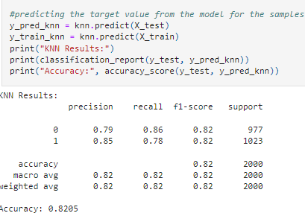
4. Model Training & Testing
There are five different classification algorithms are used for achieving best results, which are as follows:
K-Nearest Neighbour(KNN) : A simple, instance-based learning algorithm that classifies data points based on the majority label among their k nearest neighbors.

Slide 7
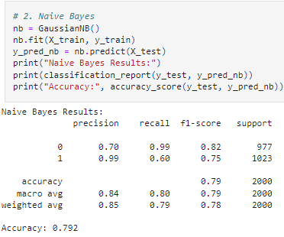
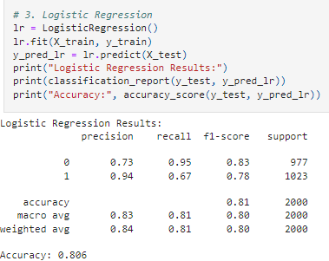
b. Naive Bayesian Classifier:
A probabilistic classifier based on Bayes' theorem, assuming strong (naive) independence between features.
c. Logistic Regression:
A statistical model for binary classification that predicts probabilities using a logistic function to map input features.

Slide 8
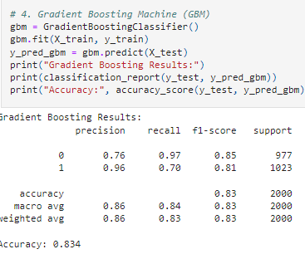
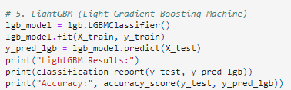
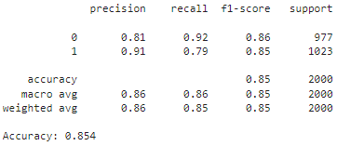
d. Gradient Boosting Machines(GBM):
An ensemble technique that builds models sequentially, where each new model corrects the errors of the previous models using gradient descent.
e. Light Gradient Boosting Machine(LGBM):
A fast, gradient-boosting framework optimized for efficiency and scalability, especially on large datasets, by using histogram-based learning and leaf-wise tree growth.

Slide 9
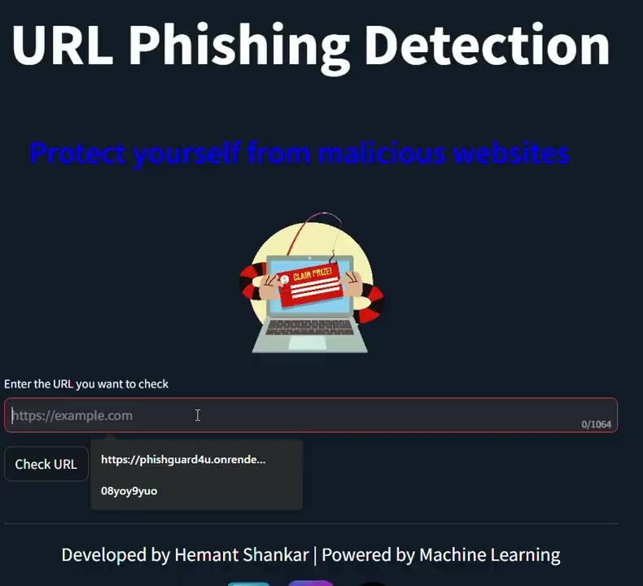
5. Building Website UI

Slide 10
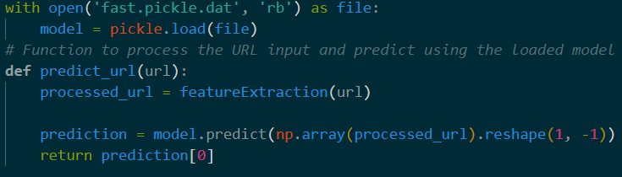
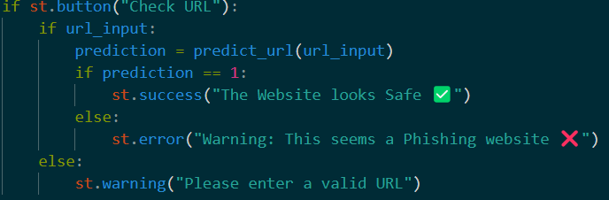
6. Input Processing & Output Generation
Step 01:
Taking input
Step 02:
Making
Prediction
Step 03:
Output
Generation

Slide 11
7. Website Deployment
Step 01: Hosting Setup
Configure server environment for website deployment.
Step 02: Deployment Process
Upload and Configure website files on server
Step 03: Testing
Verify website functionality in production environment

Slide 12
REFERENCES
https://www.unb.ca/cic/datasets/url-2016.html (Data Source)
https://doi.org/10.3390/
https://archive.ics.uci.edu/ml/datasets/Phishing+Websites
https://arxiv.org/pdf/2009.11116
Script and Data References

Slide 13
THANK YOU

